Slide 1
5S Workbench organization
06/09/21

Slide 2
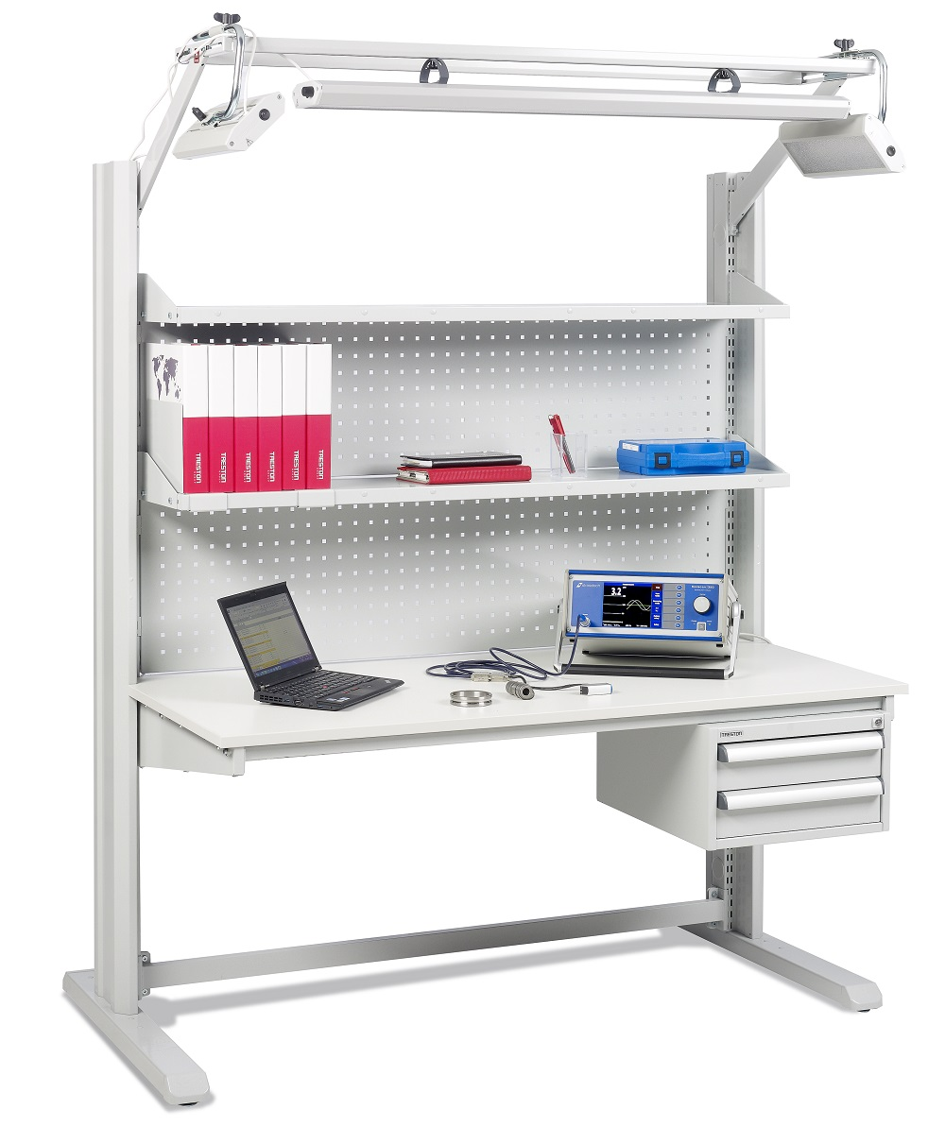
Workbench Organization – Goals
Implement the 5S methodology in real conditions
Make an efficient and organized workbench
Have an ergonomic work environment

Slide 3
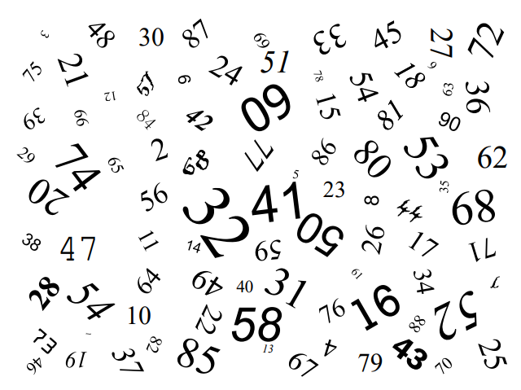
Introduction
Manufacturing process: crossing out the numbers from 1 to 49 in ascending order.
Manufacturing time: 20 seconds
Our Workbench

Slide 4
3, 2, 1 GO !!

Slide 5
Stop !
How far did you go?

Slide 6
Introducing the 5S
Are you satisfied with your performance ?
Do you think you could have done better ?
We will now improve your performances with the 5S methodology in our Workshop.

Slide 7
First ‘S’ : Seiri : Sort
First S : Sort
What does ‘sort’ mean for you?
Get rid of the useless
How can we sort this grid ?
Remove the numbers from 50 to 90

Slide 8
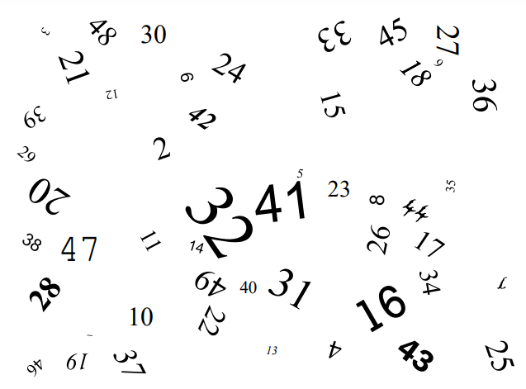
3, 2, 1 GO !!

Slide 9
Second ‘S’ : Seiton : Set in order
Second ‘S’ : Set in order
What does ‘Set in order’ mean for you?
Place each thing to a precise and accessible place
How can we implement it in our workshop ?
Let’s suppose that we have some racks, which we fill in by inserting each figure into sequence

Slide 11
Third ‘S’ : Seiso : Shine
Third ‘S’ : Shine
What does ‘shine’ mean for you in the workshop ?
Clean each time we dirty
What could be the solution in our situation ?
In each box, we should sort the numbers in a signicative order:
in ascending order in this case

Slide 13
Fourth ‘S’ : Seiketsu : Standardise
Fourth ‘S’ : Standardise
What does ‘standardise’ mean for you in the workshop ?
Entrench methods in spirits and behaviours
What could be the solution in our situation ?
The aim is to rearrange the numbers in a standard order that everyone should be able to recognize because our goal is to simplify the work.

Slide 15
Fifth ‘S’ : Standards and quality
Fifth ‘S’ : Standards and quality
Make sure that the method is respected and is up to date
Congratulations everyone !!!!

Slide 16
Another benefit of the 5S method
→ The approach we took is very important for the detection of anomalia or errors.
Imagine you are missing 3 parts
In 10 seconds, try to find the 3 missing numbers in the next sequence

Slide 18
Another benefit of the 5S method
Did you find the missing numbers ?
Now let’s try with the 5S applied to our workbench

Slide 19
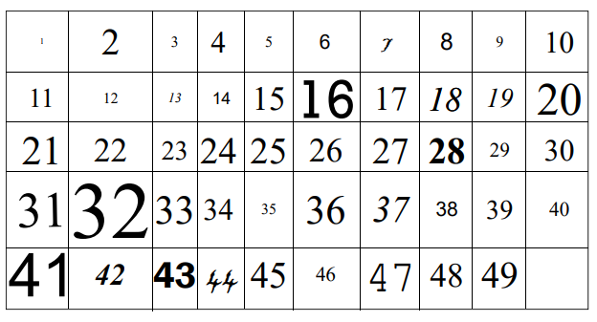

Slide 20
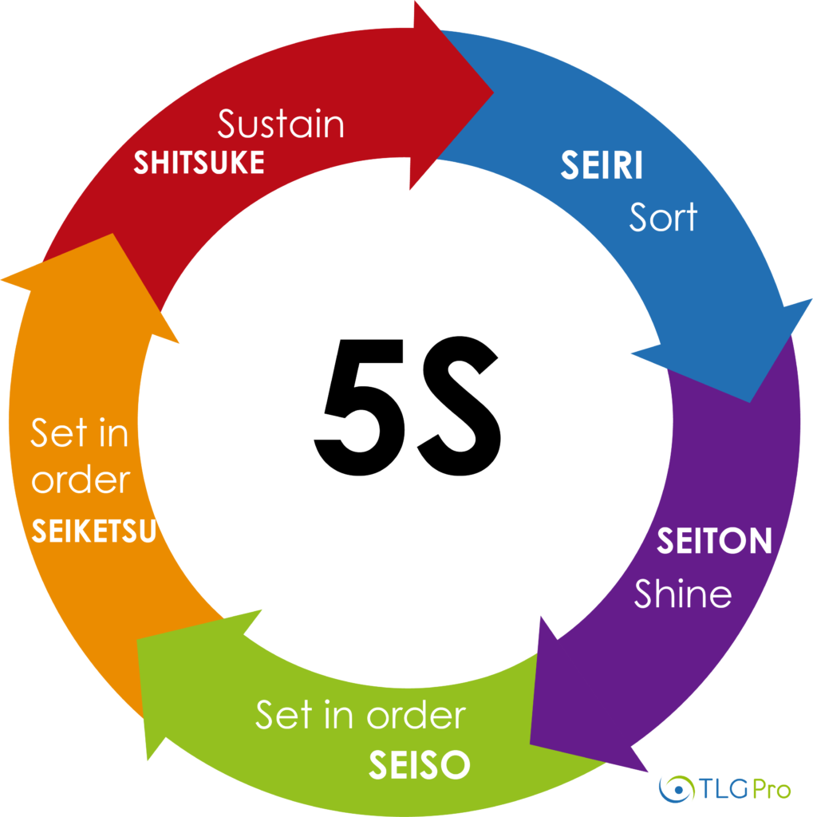
Conclusion
The true power of the 5S method:
- Easy to set in place
- Easy to understand
- Easy to maintain

Slide 21
Thank you for your attention

