Slide 1
5S Method
AUDIT GAME

Slide 2
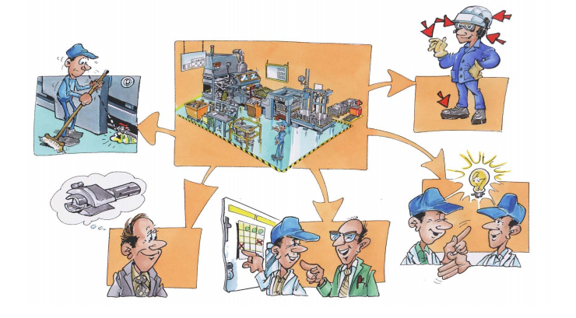
Setting up the context
The Training Center is a SMI that designs,
manufactures, and markets premium products
Online such as a connected speaker.
The workshop’s responsible figured out that the
organisation of the different workbenches and
the workshop itself aren’t optimal.
Your goal is to do an audit on the working
conditions and the organisation of the different
workbenches.

Slide 3
First audit
You will find the link for the Game :
https://docs.google.com/
forms/d/1UuJvieZ1sY69o
YGr4iflBUASRgMRiA6anIqYc
8WGchk/edit

Slide 4
Results for the first audit

Slide 5
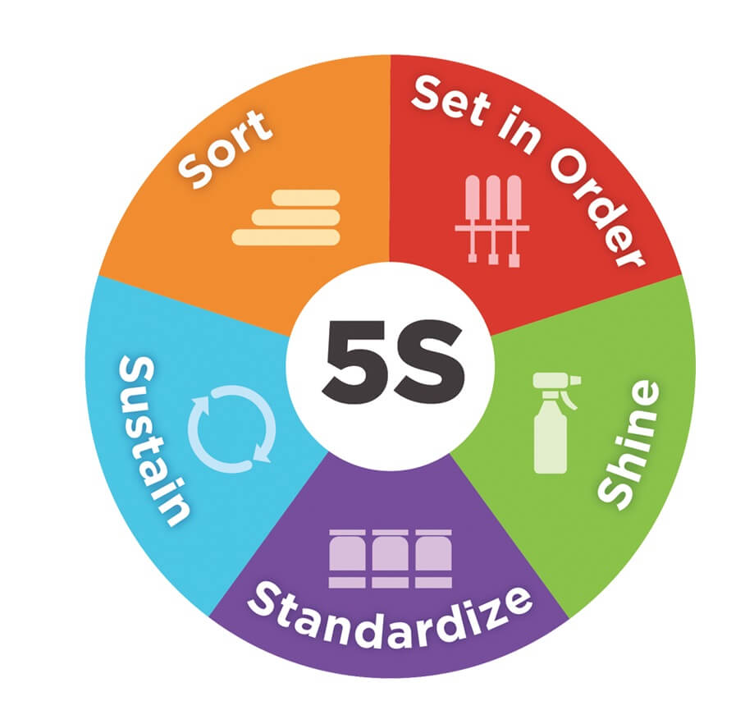
Questioning
How will you improve the situation ?
Give your ideas on the following board :
Be careful to follow well the 5S Method. Just remember :

Slide 6
Second audit
You will find the link for the Game :
https://docs.google.com/forms/d/
18LurpR-UXomcIxwVEjJPgQFbrgF
JRqOSOaI1mjfzl0c/edit

Slide 7
Results for the second audit

Slide 8
Results
Benefits of the 5S Method

Slide 9
Thanks for listening

